Slide 1
We are the DUKES!
Wellington Exempted Village Schools
Building a PLAN to fulfill our VISION

Slide 2
Today’s Agenda
Wellington Exempted Village Schools
Translating our VISION into a REALITY
District Vision
Academics
Programming
Action Steps

Slide 3
Our Vision
Wellington Exempted Village Schools
Our vision is to create a dynamic, supportive learning environment where all students develop adaptability, positive self-worth, with the skills needed to grow socially, emotionally, and academically. By fostering strong connections to school and community, we empower our students to advocate for themselves to design their own future as productive, engaged, resilient, and empathetic members of society.
Once a Duke, always a Duke.

Slide 4
Wellington Exempted Village Schools
Early Childhood
Adolescence
Ages 3-5
Basic understanding of one’s self
Ages 12-18
Self-esteem fluctuates due to hormonal changes and social pressures
Self
Actualization
The process of achieving your full potential by pursuing personal growth, creativity, and self-fulfillment
Middle Childhood
Young Adult
Ages 6-11
Self-esteem increase through independence and social interaction
Ages 19-30
Self-esteem often rises from career successes and interpersonal relationships

Slide 5
GRADUATION is not the goal …
The GOAL is ensure our students leave WEVS prepared to be happy and successful on the path they have chosen.
1. Start with your STRENGTHS
2. Own YOUR Future
Identify what skills you are strong in, develop those, and build from there.
Pick a direction and confidently move forward. You can always pivot.
3. Align COURSES & PROGRAMS
4. Give OPPORTUNITIES
Explore pathways, build experiences, and develop skills that you can use.
Show our kids what doors can be opened and help them apply what they have learned.

Slide 6
If we show them that they can be successful and believe in them, then they will believe in themselves.

Slide 7
Start with Your
Strengths & Aptitudes
1. YouScience
Identifies student’s strengths and aptitudes
Shares specific careers that you would be strong at
Links college and career programs that fit you
Works with SchoolLinks program
Middle School and High School
2. StrengthsFinder 2.0
Identifies your top five strength attributes
Helps show you how your strengths can support your weaknesses
Shows how people with different strengths can come together to be a powerful team
High School

Slide 8
Academic Courses
Stepping stones to achieve your dream
Wellington Exempted Village Schools
1. English Language Arts
2. Mathematics
The art of communicating knowledge and ideas through words both written and spoken
The art of problem solving, analytical thinking and understanding abstract concepts
3. Science
4. Social Studies
Exploring and understanding the world around you so that you can make informed decisions
Learning about ourselves by understanding our past, other cultures, and current events.
5. Electives
6. Durable Skills
Devote time towards individual talents, self-exploration, artistic expression, and well-rounded experiences
Social/emotional wellness, adaptability, perseverance, sense of community, and citizenship

Slide 9
Choosing YOUR Future
Strengths & Aptitudes
Interests
Requirements and Opportunities
What is your skill set and what are you good at?
It feels good to be successful and it encourages you to persevere.
What do you like to do?
No one wants to work on things that they do not like. Find a career that you love and be happy going to work.
What steps do you have to take to be qualified for your dream job?
How can you start preparing now?

Slide 10
Wellington Exempted Village Schools
Prerequisites
Rigor Level
CCP & AP
Career Tech Ed. (CTE)
Some classes must be taken in order because they build on each other.
Some classes are tiered as advanced or honors levels. “Straight A’s” is not the goal. Appropriate stretch is.
Some courses can earn you high school and college credit.
Some classes can earn you credentials and badges that prepare you for the workforce.

Slide 11
Our Partnerships
It takes a village
Kiwanis & Local Businesses
LCCC
Lorain County JVS
Lorain County Business Advisory Committee

Slide 12
Taking STEPS to make your VISION a REALITY
Choose a DIRECTION, but keep doors OPEN
Plan out multiple years with an end goal in mind
Start with a wide scope and narrow over time
Do not rush the process
Remember, the GRADUATION is not the goal
Know the BENCHMARKS
Each year has its OPPORTUNITIES and CHALLENGES
You only go through school once. Don’t leave with regrets
We are here to guide you through

Slide 13
Our ADVICE for each YEAR
7th Grade
8th Grade
Freshmen
Sophomores
Juniors
Seniors

Slide 14
Advice to
7th Grade
Students
Stay Organized
Develop Good Study Habits
Ask Questions
Be Responsible
Stay Positive
Balance and Fun
Be Kind
Take Care of Yourself
Transition To “Student Driven”

Slide 15
Advice to
8th Grade
Students
Start Preparing for High School
Focus on Your Academic Growth
Be a Role Model
Get Involved
Build Strong Relationships
Stay Balanced
Stay Curious and Keep Learning
Set Goals for the Year
Don’t Stress About High School
Even more pathways that are “Student Driven”

Slide 16
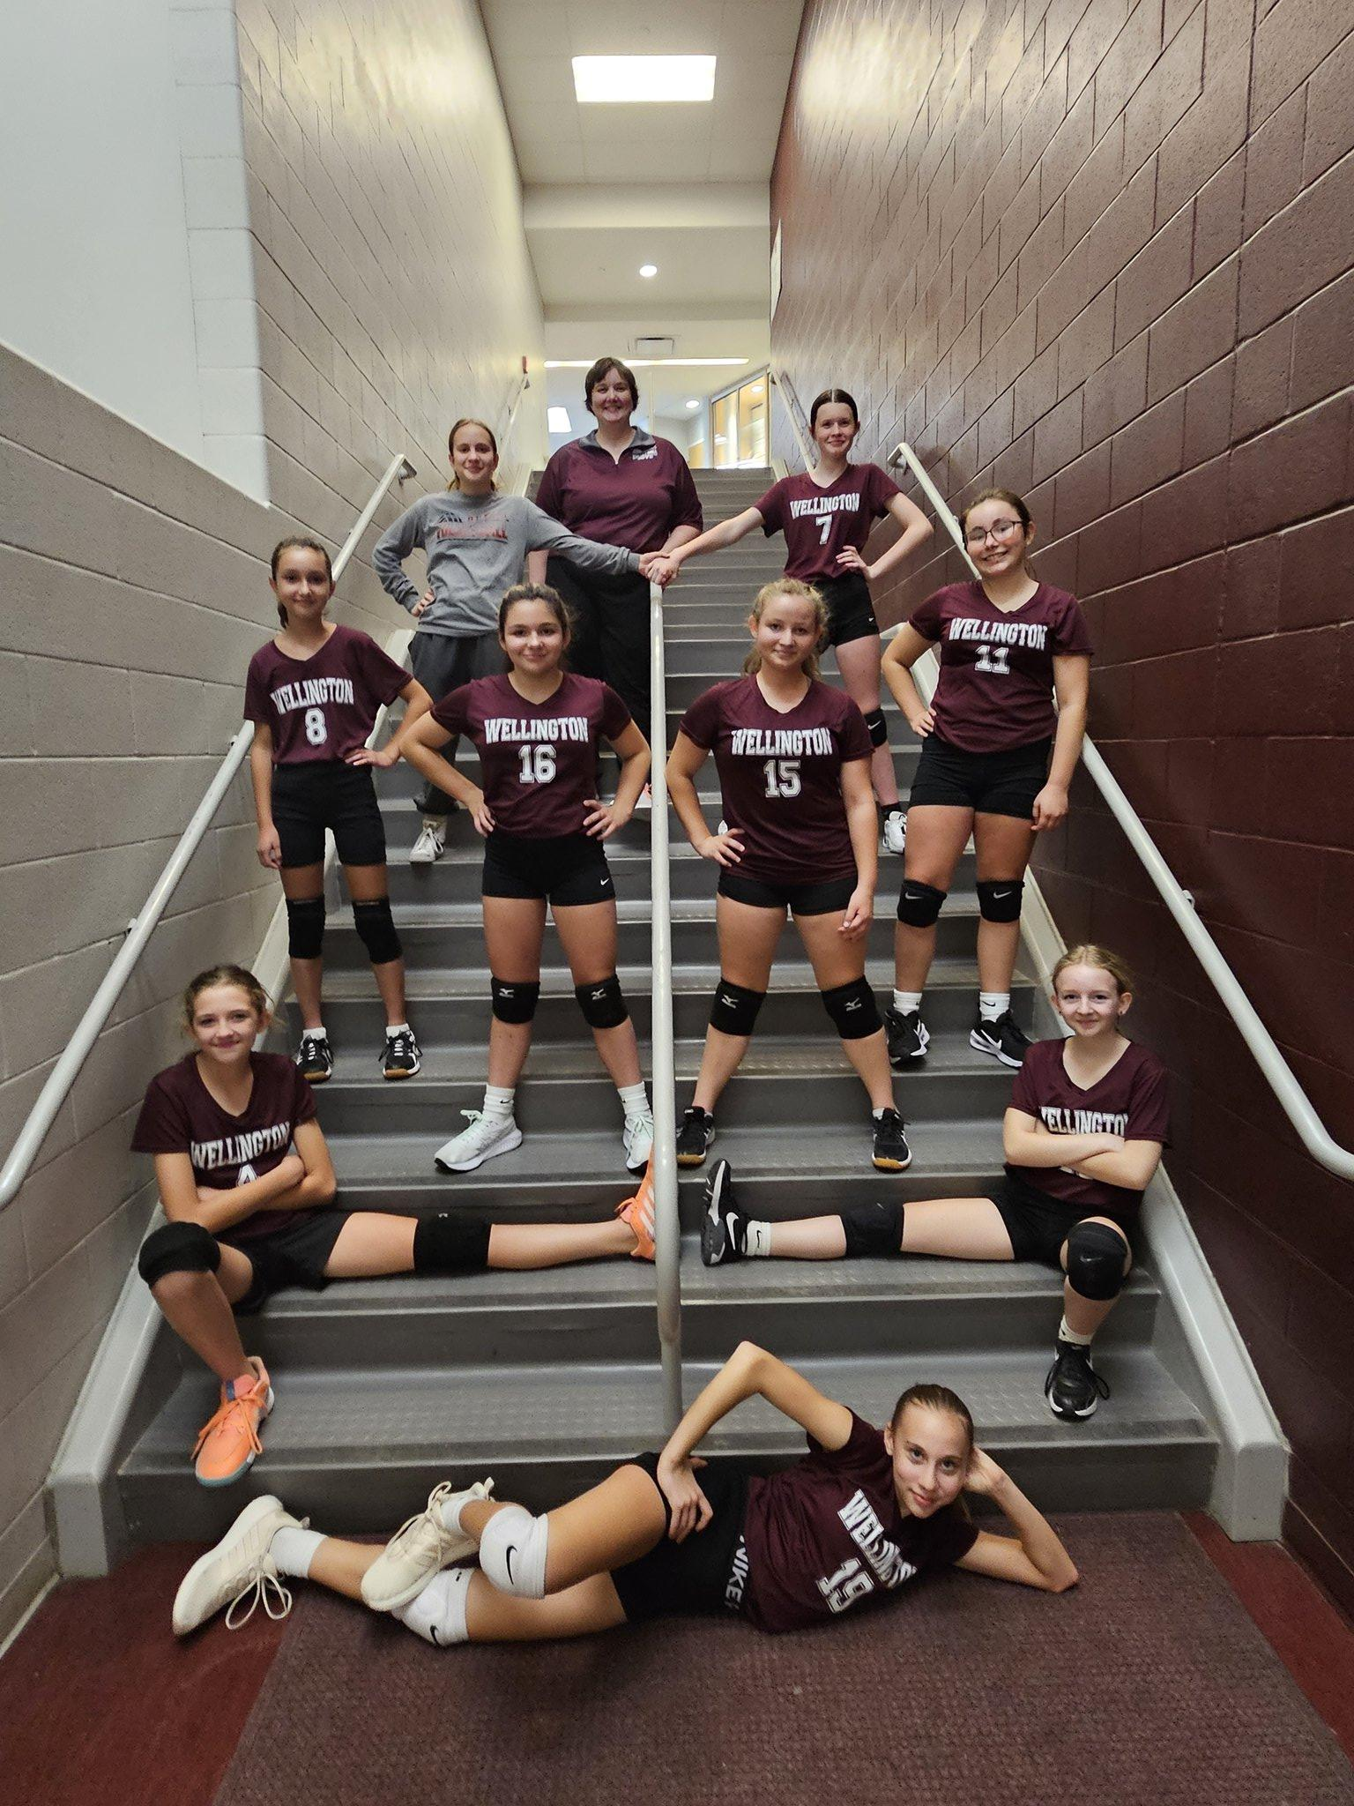
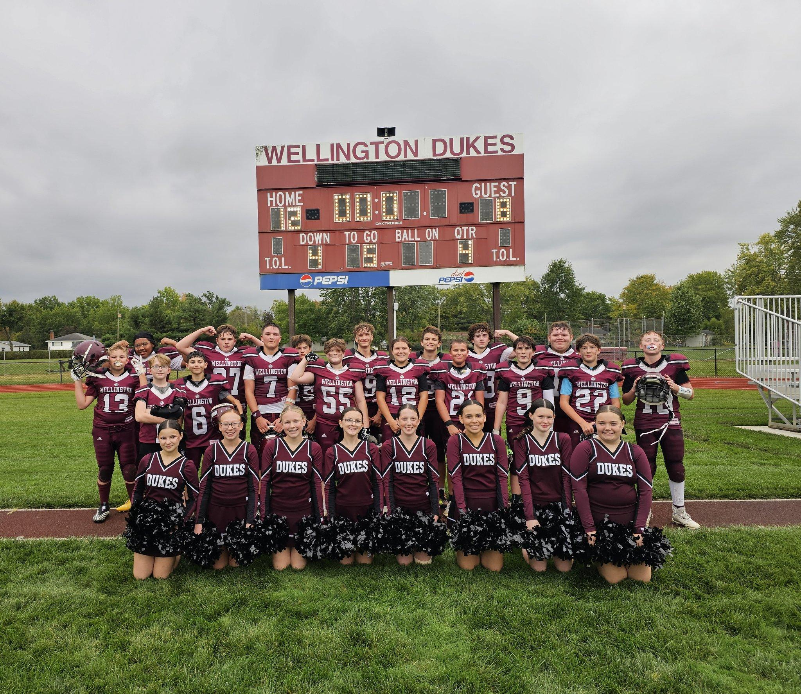
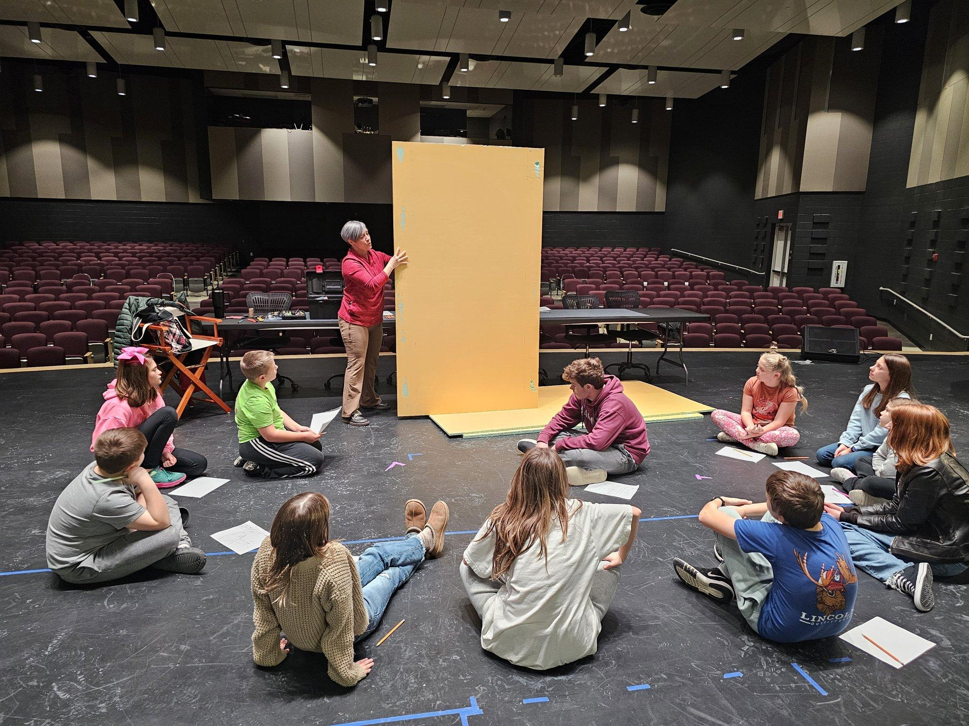
Balance School and Fun/Get Involved
Track
Football
Builders Club
Cross Country/Junior Running Club
FFA
Softball
Volleyball
Band and Choir
SAC and Student Council
Wrestling
Drama Club
Cheerleading
Boys and Girls Basketball
H.I.K.E Club

Slide 17
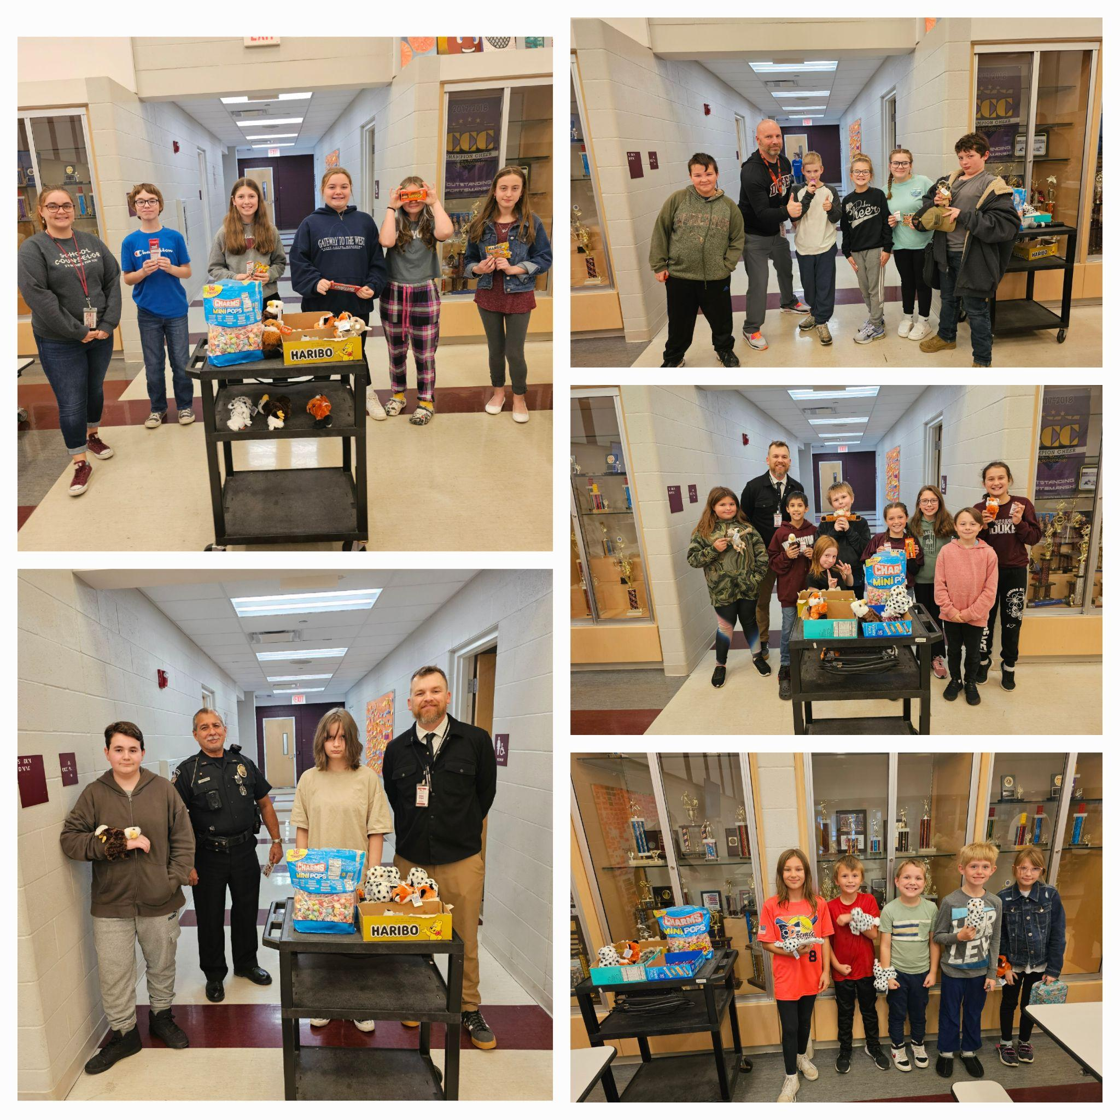
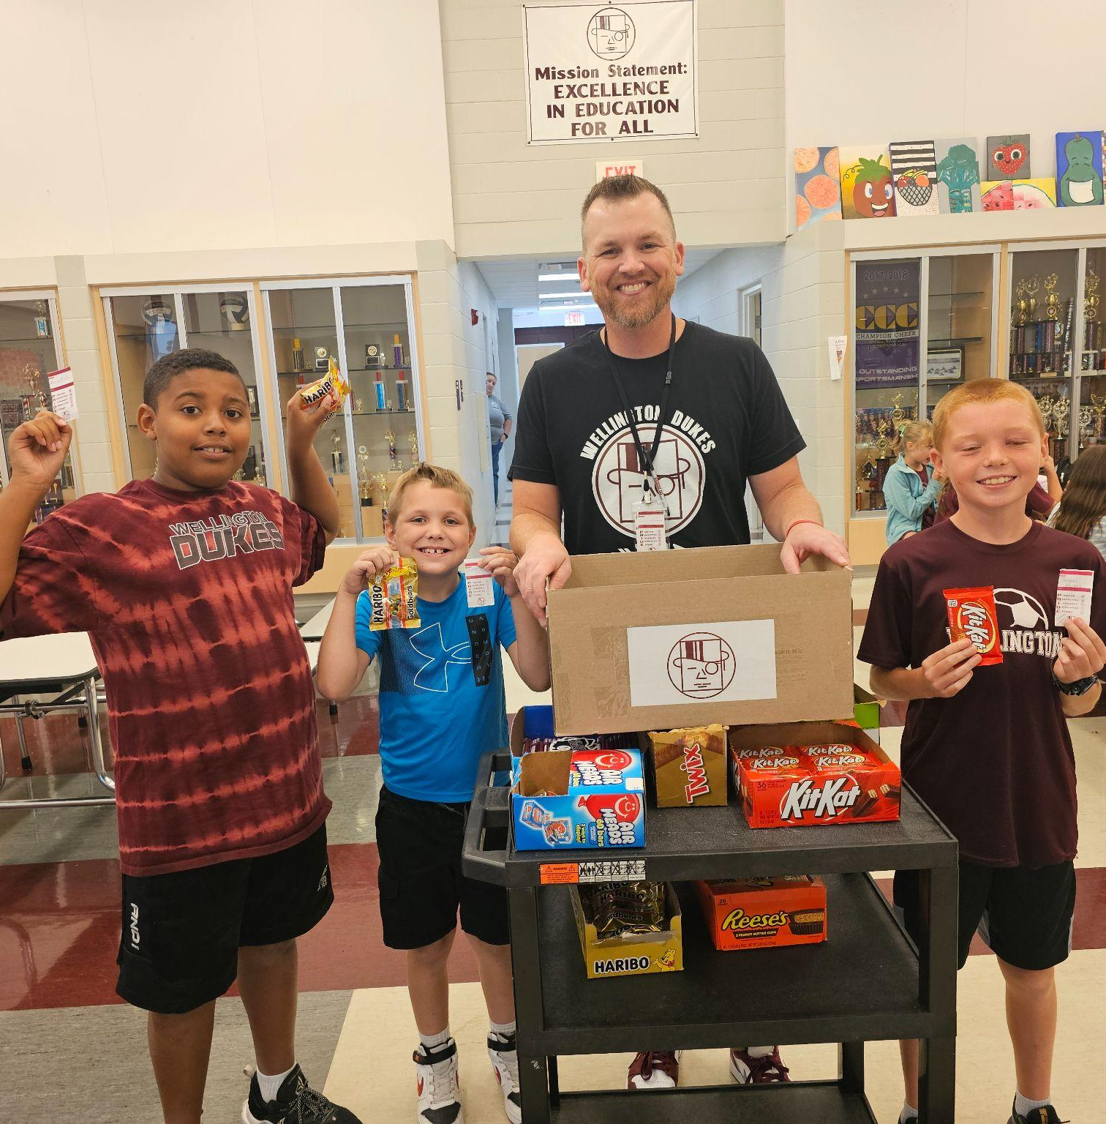
Implementation of PBIS at MMS
Mr. Morris PBIS Trophy
PBIS Kickoff
Incentive Trips
Increase in Validation Tickets
PBIS Daily Drawings
Students of the Semester
Friday Drawings
Duke Pride Champion
PBIS Lessons/ Recalibration

Slide 18
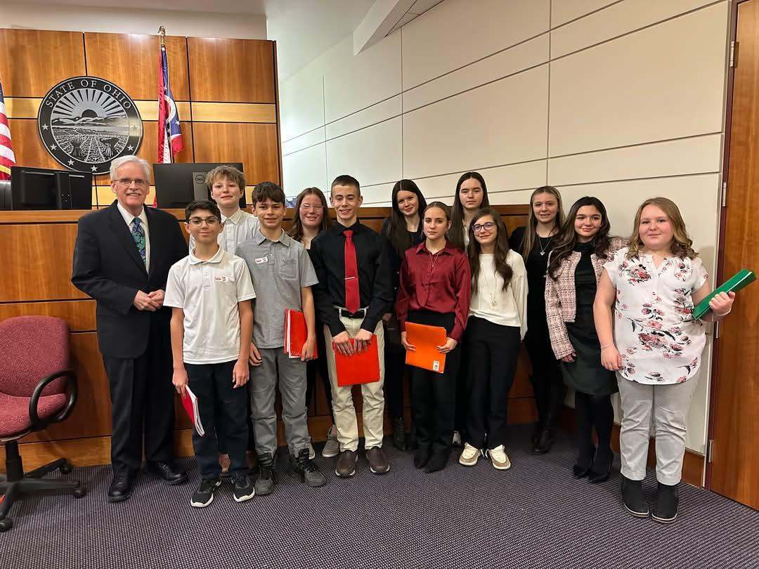
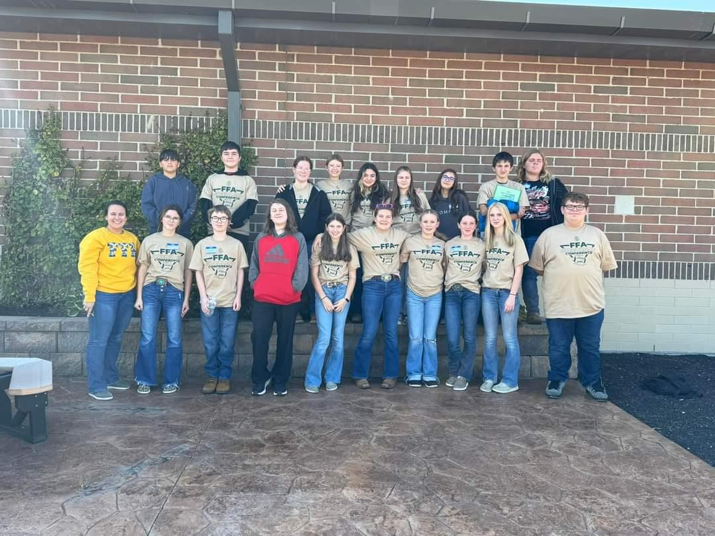
Academic Information
YouScience
New Curriculum this Year
Connecting Aptitudes and Interests
Exact Path and ALEKs
Electives
Working Together
Student Voice and Choice
Formula for Success

Slide 19
High School Curriculum
Where Do I Find Information?
www.wellingtonvillageschools.org
Links to Helpful Resources…
Course Catalog | CCP Information | Grad Requirements
PowerSchool |  | Staff Contacts
Student Handbook | Pay Schools Central | SchooLinks (coming soon)

Slide 20
Wellington High School Graduation Requirements

Slide 21
3 Compenents
The Basics
Credits, Testing, & Community Service
+
Competency
+
Readiness

Slide 22
Course Credits
&
Testing Requirements
20 CREDITS
6 End-Of-Course Exams
(Ohio State Tests)
SAT

Slide 23
ENGLISH LANGUAGE ARTS | MATH | SCIENCE | SOCIAL STUDIES
4 | 4 | 3 | 3
HEALTH | PHYSICAL EDUCATION | ELECTIVES | TESTING REQUIREMENTS
.5 | .5 | 5 | English Lang Arts II Algebra I, Geometry, American History, Government & Biology
CREDIT REQUIREMENT TOTAL: 20 Credits 6 End of Course Exams

Slide 24
CREDIT NOTES
See Course Catalog for additional information
PHYSICAL EDUCATION:
A Physical Education (PE) Waiver may be obtained if a student participates in two FULL seasons of a high school interscholastic sport(s), marching band, and/or cheerleading.
ELECTIVES:
Any combination of world language, fine arts, business, career-technical education, technology, agricultural education courses. Electives also include English, math, science, or social studies courses which are not otherwise required.
Students must earn at least .5 credit in Financial Literacy and 1 credit in Fine Arts (Fine arts may not be required for students in some career-tech programs)
TESTING:
All 6 End of Course (EOC) Exams are required to be taken by all students regardless of desired pathway.
Ohio Department of Education & Workforce - Graduation Requirements 2023 & Beyond

Slide 25
COMMUNITY SERVICE
Graduation Requirement
32 Hours of Service
* 8 hours per year that the student is enrolled in Wellington.
* Service hours must be entered into SchooLinks in order to be verified & approved by the school counselor and/or administration (Beginning 25-26).
Notes:
9th grade students are not imported yet so you cannot do this yet! Should be set up in the next 1-2 weeks.

Slide 26
DEMONSTRATING COMPETENCY
Biology
American History
American Government
Geometry
Algebra 1
English language arts II

Slide 27
DEMONSTRATING COMPETENCY
END OF COURSE EXAMS:
All students must take the 6 End of Course exams, but competency is only demonstrated on English language arts II and Algebra I.
Competency = a score of 684 or higher.
Students not earning a 684 competency score or higher on their first attempt must retake the exam at least one additional time.
In lieu of competency scores on the state tests, students can choose alternative pathways to demonstrate competency, but only AFTER they have made a second attempt on the ELA II and Algebra I exams.
English language arts II | 684
Algebra I | 684
Notes:
9th grade students are not imported yet so you cannot do this yet! Should be set up in the next 1-2 weeks.

Slide 28
DEMONSTRATING COMPETENCY
Alternative Pathways To Demonstrating Competency
Students can only choose to use one of these alternative pathways to demonstrate competency, AFTER they have made a second attempt on the ELA II and Algebra I End-of-Course exams.
College Credit Plus:
Successful completion of non-remedial CCP courses that have been approved by ODEW as a means of demonstrating competency.
ACT or SAT:
A remediation-free score in the math or English subject areas on the ACT or SAT.
SAT: Reading & Writing = 480 , Math = 530
ACT: Subscores in English = 18, Reading = 22, Math = 22
Military Enlistment:
Meeting the requirements to enlist in the military, which requires a military contract stating that the student will be enlisting upon graduation.
Notes:
9th grade students are not imported yet so you cannot do this yet! Should be set up in the next 1-2 weeks.

Slide 29
DEMONSTRATING COMPETENCY
Alternative Pathways To Demonstrating Competency
Students can only choose to use one of these alternative pathways to demonstrate competency, AFTER they have made a second attempt on the ELA II and Algebra I End-of-Course exams.
Career Experience and Technical Skill:
Students must complete two of the options from the list below with at least one of the options being a foundational option.
Foundational Options:
Earn a cumulative score of proficient or higher on three or more WebXams in a single career pathway;
Earn a 12-point approved industry-recognized credential or group of credentials totaling 12 points in a single career field;
Complete a pre-apprenticeship program (recognized by the Ohio State Apprentice Council (OSAC))
Obtain a state-issued license for practice in a vocation that requires an examination.
Supporting Options
Complete a 250-hour work-based learning experience with evidence of positive evaluations;
Meet the National Career Readiness Silver Level on the WorkKeys*; or
Earn the OhioMeansJobs-Readiness Seal.
Notes:
9th grade students are not imported yet so you cannot do this yet! Should be set up in the next 1-2 weeks.

Slide 30
DEMONSTRATING
READINESS
Students must earn at least two diploma seals.
12 seals available:
9 = State-Defined Seals
3= Locally-Defined Seals
One of the two seals earned MUST be a State-Defined Seal.
The additional seal may be State-Defined or Locally-Defined.
Learn More about Graduation Seals
* Students are encouraged to earn the seals that align with their goals and interests.

Slide 31
DEMONSTRATING
READINESS

Slide 32
DEMONSTRATING
READINESS
STATE-DEFINED SEALS
Students must earn at least ONE State-Defined Seal

Slide 33
DEMONSTRATING
READINESS
LOCAL SEALS
Students must earn at least ONE State Seal
The additional seal can be another State Seal or a Local Seal
Community Service Seal: Obtain 20 hours of service, in addition to the current WHS Community Service Requirement for graduation.
Fine & Performing Arts Seal: (must meet ONE of the following requirements):
Earn 4 or more credits in the area of fine arts, and maintain a cumulative GPA of 2.5 or higher in those courses.
Participate in a minimum of 3 theater productions through the Drama Club and/or Community Theater.
Student Engagement Seal: (must meet ONE of the following requirements)
Participate in a minimum of 3 seasons with any school-sponsored sports/athletic team.
Participate in any school-sponsored club for a minimum of 3 years.

Slide 34
How do I keep track of it all?
Coming soon to Wellington…
SchooLinks
SchooLinks is a one stop shop for college and career readiness!!
The program will be fully implemented in grades 6-12 for the 25-26 school year!
✅ Career interest inventory, the Game of Life (career pathways)
🍎 School → Course pathways, test scores, grades, transcripts, teacher recommendation letters, etc…
💼 Careers → Opportunities, education needed, availability, growth, virtual reality tours
🏫 Colleges → School search, college applications
📈Scattergrams, aptitude assessments, community service hour tracker
💰Finances → Scholarship matching & management, post-secondary expense estimates, FAFSA tracker
AND SO MUCH MORE!!

Slide 35
Freshmen
Don’t overthink your course selections your freshman year!
Freshman courses follow a general college and career curriculum that allows students to transition into any desired pathway as they progress through HS.
Most colleges/universities still want 2-4 years of a world language even though it is not a graduation requirement.
Keep as many doors open for as long you can. You will change your mind.
Find a school life and extracurricular/personal balance.
Wellington classes prepare you for future better than online courses do.
Electives are important too!
A little advice for your first year of high school…

Slide 36
Some More Advice to Our Freshmen
Let’s Start Off With the End in Mind
Do not delay graduation requirements!
Early preparation allows for flexibility later
Follow this template freshmen year:
English 9*
Algebra I*
Physical Science
Modern World History
Elective course: Art, Band, Choir, Spanish I
Physical Education
* Honors courses are available. Requires Teacher Recommendation and/or prerequisite courses.

Slide 37
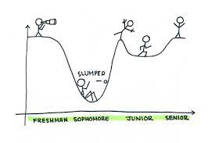
Sophomores
This is a year of HUGE milestones! Great news is that we know you are ready for it even if you don’t.
You have started to plan for your future, it is now time to make it a reality.
Get involved in school activities and find time to volunteer.
Most of you will have a job for the next 50 years so enjoy being a high school kid.
Meet with your counselor now so we can align your dreams with your path.
A year filled with milestones…

Slide 38
Advice We Can Give to Juniors
Now is the time be the person you want to be.
This is the year of action. Take control of your outcomes.
Have a solid plan and go confidently in the direction you choose. If things change, so can your plan.
Keep moving forward.
Build your resume through actions and not words.

Slide 39
Advice We Can Give to Seniors
Here is a secret; graduation was never the goal. What you do AFTER high school is.
Here is another secret; acceptance into a “dream” school is not a measure of your worth. Postsecondary education does not have to be a four year college or university! There are MANY options…just be sure to have an option.
Just because you have the credits to graduate does not mean that your training is complete.
There are more lessons to learn in high school than the courses that we offer. Being involved is important!
Make sure you are creating memories while you are here, and that you are turning into the person that you will be proud of in 10, 20, 30+ years from now.
There is no reason to sprint to this finish line. Enjoy the victory lap.

Slide 40
WELLINGTON HS COURSE OFFERINGS

Slide 41
COLLEGE CREDIT PLUS
Attend a CCP Informational Meeting (see dates on handout)
Complete the Intent to Participate Form and Proof of Meeting
Complete CCP College Application
Upon acceptance into LCCC (or other college/university), take placement assessment
Complete the Authorization Form
Schedule an appointment with a college advisor for course scheduling

Slide 42
THANK YOU
Any Questions?
Wellington Exempted Village Schools

